Slide 1
Intro Slide (Name, Admin, etc.)

Slide 2
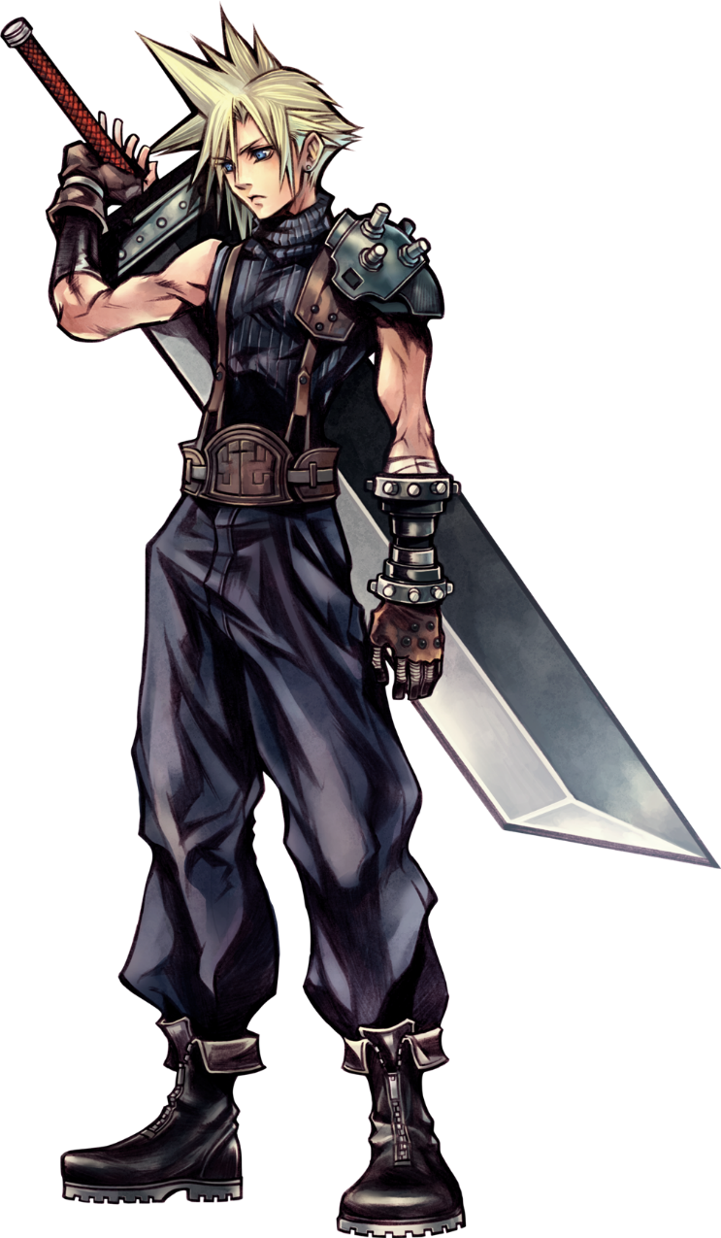
Character 1 Name
Created by: Student 1 Name
Name: XXX
Other relevant info, etc.
(Can be more than 1 slide)

Slide 3
Character 1 Name
Personality Score:
STRENGTHS
 | Popular Sanguine |  | Powerful Choleric |  | Perfect Melancholy |  | Peaceful Phlegmatic
1 |  | Animated |  | Adventurous |  | Analytical |  | Adaptable
2 |  | Playful |  | Persuasive |  | Persistent |  | Peaceful
3 |  | Sociable |  | Strong-willed |  | Self-sacrificing |  | Submissive
4 |  | Convincing |  | Competitive |  | Considerate |  | Controlled
5 |  | Refreshing |  | Resourceful |  | Respectful |  | Reserved
6 |  | Spirited |  | Self-reliant |  | Sensitive |  | Satisfied
7 |  | Promoter |  | Positive |  | Planner |  | Patient
8 |  | Spontaneous |  | Sure |  | Scheduled |  | Shy
9 |  | Optimistic |  | Outspoken |  | Orderly |  | Obliging
10 |  | Funny |  | Forceful |  | Faithful |  | Friendly
11 |  | Delightful |  | Daring |  | Detailed |  | Diplomatic
12 |  | Cheerful |  | Confident |  | Cultured |  | Consistent
13 |  | Inspiring |  | Independent |  | Idealistic |  | Inoffensive
14 |  | Demonstrative |  | Decisive |  | Deep |  | Dry humor
15 |  | Mixes easily |  | Mover |  | Musical |  | Mediator
16 |  | Talker |  | Tenacious |  | Thoughtful |  | Tolerant
17 |  | Lively |  | Leader |  | Loyal |  | Listener
18 |  | Cute |  | Chief |  | Chartmaker |  | Contented
19 |  | Popular |  | Productive |  | Perfectionist |  | Pleasant
20 |  | Bouncy |  | Bold |  | Behaved |  | Balanced
 | 0 |  | 0 |  | 0 |  | 0
WEAKNESSES
 | Popular Sanguine |  | Powerful Choleric |  | Perfect Melancholy |  | Peaceful Phlegmatic
1 |  | Brassy |  | Bossy |  | Bashful |  | Blank
2 |  | Undisciplined |  | Unsympathetic |  | Unforgiving |  | Unenthusiastic
3 |  | Repetitious |  | Resistant |  | Resentful |  | Reticent
4 |  | Forgetful |  | Frank |  | Fussy |  | Fearful
5 |  | Interrupts |  | Impatient |  | Insecure |  | Indecisive
6 |  | Unpredictable |  | Unaffectionate |  | Unpopular |  | Uninvolved
7 |  | Haphazard |  | Headstrong |  | Hard to please |  | Hesitant
8 |  | Permissive |  | Proud |  | Pessimistic |  | Plain
9 |  | Angered easily |  | Argumentative |  | Alienated |  | Aimless
10 |  | Naïve |  | Nervy |  | Negative attitude |  | Nonchalant
11 |  | Wants credit |  | Workaholic |  | Withdrawn |  | Worrier
12 |  | Talkative |  | Tactless |  | Too sensitive |  | Timid
13 |  | Disorganized |  | Domineering |  | Depressed |  | Doubtful
14 |  | Inconsistent |  | Intolerant |  | Introvert |  | Indifferent
15 |  | Messy |  | Manipulative |  | Moody |  | Mumbles
16 |  | Show-off |  | Stubborn |  | Skeptical |  | Slow
17 |  | Loud |  | Lord over others |  | Loner |  | Lazy
18 |  | Scatterbrained |  | Short-tempered |  | Suspicious |  | Sluggish
19 |  | Restless |  | Rash |  | Revengeful |  | Reluctant
20 |  | Changeable |  | Crafty |  | Critical |  | Compromising
 | 0 |  | 0 |  | 0 |  | 0

Slide 4
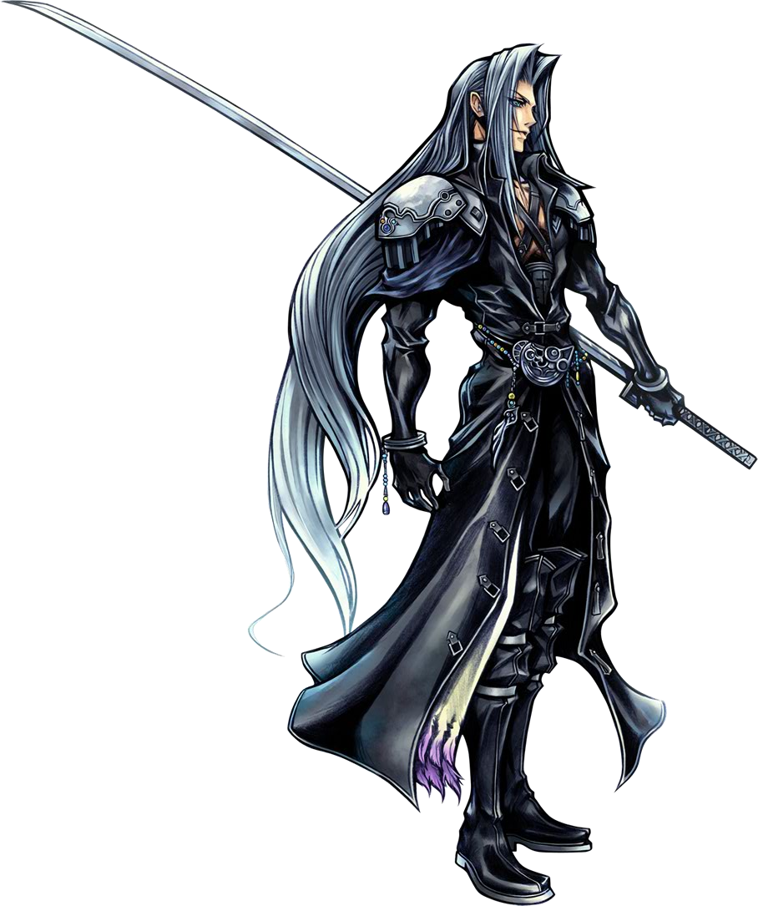
Character 2 Name
Created by: Student 2 Name
Name: YYY
Other relevant info, etc.
(Can be more than 1 slide)

Slide 5
Character 2 Name
Personality Score:
STRENGTHS
 | Popular Sanguine |  | Powerful Choleric |  | Perfect Melancholy |  | Peaceful Phlegmatic
1 |  | Animated |  | Adventurous |  | Analytical |  | Adaptable
2 |  | Playful |  | Persuasive |  | Persistent |  | Peaceful
3 |  | Sociable |  | Strong-willed |  | Self-sacrificing |  | Submissive
4 |  | Convincing |  | Competitive |  | Considerate |  | Controlled
5 |  | Refreshing |  | Resourceful |  | Respectful |  | Reserved
6 |  | Spirited |  | Self-reliant |  | Sensitive |  | Satisfied
7 |  | Promoter |  | Positive |  | Planner |  | Patient
8 |  | Spontaneous |  | Sure |  | Scheduled |  | Shy
9 |  | Optimistic |  | Outspoken |  | Orderly |  | Obliging
10 |  | Funny |  | Forceful |  | Faithful |  | Friendly
11 |  | Delightful |  | Daring |  | Detailed |  | Diplomatic
12 |  | Cheerful |  | Confident |  | Cultured |  | Consistent
13 |  | Inspiring |  | Independent |  | Idealistic |  | Inoffensive
14 |  | Demonstrative |  | Decisive |  | Deep |  | Dry humor
15 |  | Mixes easily |  | Mover |  | Musical |  | Mediator
16 |  | Talker |  | Tenacious |  | Thoughtful |  | Tolerant
17 |  | Lively |  | Leader |  | Loyal |  | Listener
18 |  | Cute |  | Chief |  | Chartmaker |  | Contented
19 |  | Popular |  | Productive |  | Perfectionist |  | Pleasant
20 |  | Bouncy |  | Bold |  | Behaved |  | Balanced
 | 0 |  | 0 |  | 0 |  | 0
WEAKNESSES
 | Popular Sanguine |  | Powerful Choleric |  | Perfect Melancholy |  | Peaceful Phlegmatic
1 |  | Brassy |  | Bossy |  | Bashful |  | Blank
2 |  | Undisciplined |  | Unsympathetic |  | Unforgiving |  | Unenthusiastic
3 |  | Repetitious |  | Resistant |  | Resentful |  | Reticent
4 |  | Forgetful |  | Frank |  | Fussy |  | Fearful
5 |  | Interrupts |  | Impatient |  | Insecure |  | Indecisive
6 |  | Unpredictable |  | Unaffectionate |  | Unpopular |  | Uninvolved
7 |  | Haphazard |  | Headstrong |  | Hard to please |  | Hesitant
8 |  | Permissive |  | Proud |  | Pessimistic |  | Plain
9 |  | Angered easily |  | Argumentative |  | Alienated |  | Aimless
10 |  | Naïve |  | Nervy |  | Negative attitude |  | Nonchalant
11 |  | Wants credit |  | Workaholic |  | Withdrawn |  | Worrier
12 |  | Talkative |  | Tactless |  | Too sensitive |  | Timid
13 |  | Disorganized |  | Domineering |  | Depressed |  | Doubtful
14 |  | Inconsistent |  | Intolerant |  | Introvert |  | Indifferent
15 |  | Messy |  | Manipulative |  | Moody |  | Mumbles
16 |  | Show-off |  | Stubborn |  | Skeptical |  | Slow
17 |  | Loud |  | Lord over others |  | Loner |  | Lazy
18 |  | Scatterbrained |  | Short-tempered |  | Suspicious |  | Sluggish
19 |  | Restless |  | Rash |  | Revengeful |  | Reluctant
20 |  | Changeable |  | Crafty |  | Critical |  | Compromising
 | 0 |  | 0 |  | 0 |  | 0

Slide 6
Synopsis
XXX sees YYY and greets him, etc.

Slide 7
Dialogue
XXX “Hello!”
YYY sees XXX waving at him and waves back, “Hey! Your sword looks heavy!”
Etc.

Slide 8


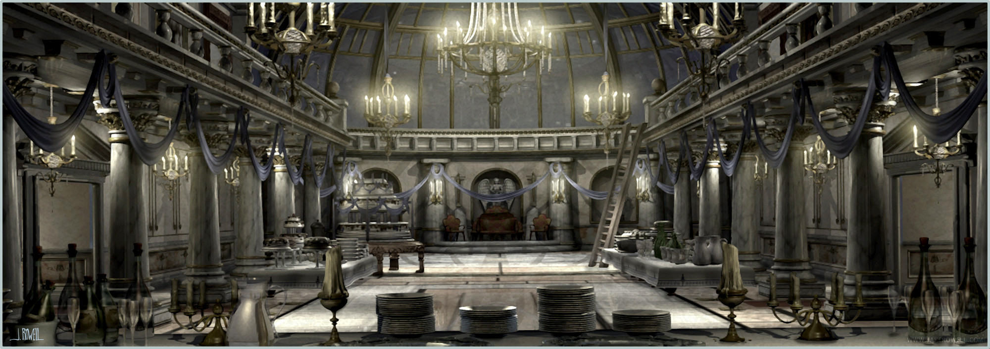
XXX
Hello!

Slide 9

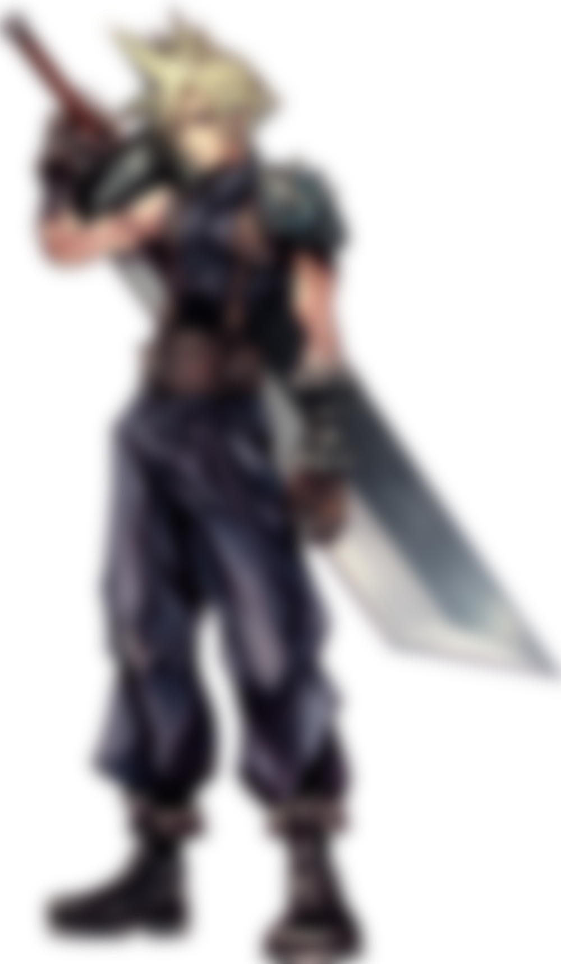
YYY
Hey! Your sword looks heavy!

